Slide 1

DCS Vendor’s and Meditech Access
Presented By-Pan Dhoni

Slide 2
Agenda
Types of Insurance Coverage
About collection Vendor’s and related Applications
Use of Access in Meditech
Process flow for external vendors accessing Meditech screens
Three Primary Access levels
Dictionary Mapping
Files Used in DCS

Slide 3
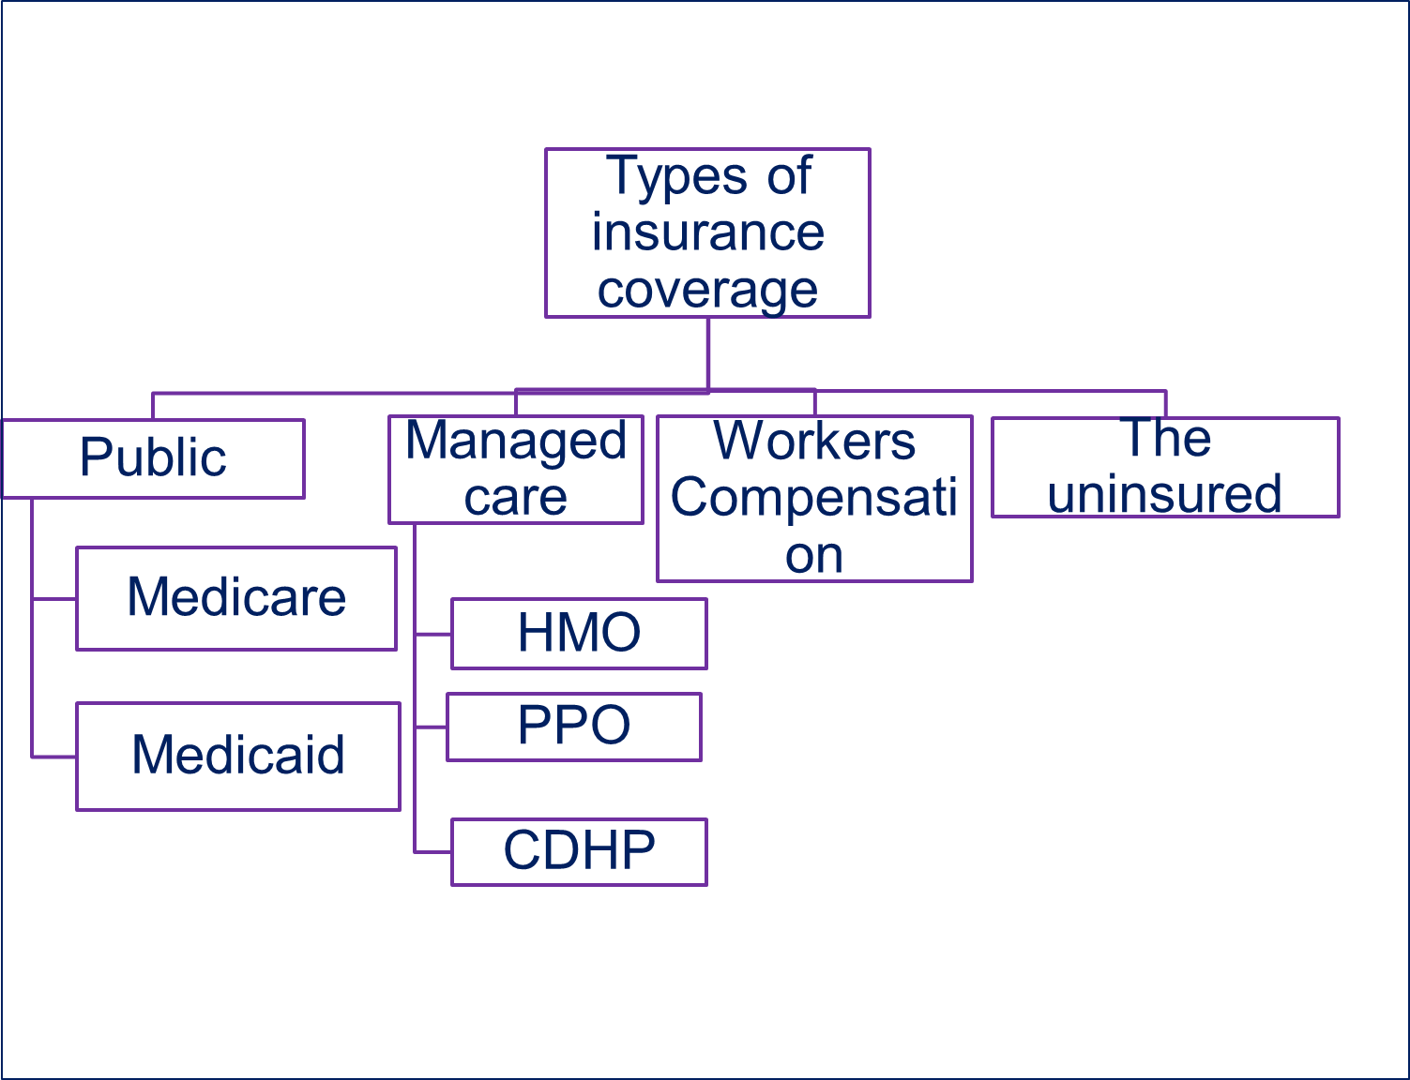
Legal

Slide 4
Why Collection Vendor?
“The billing and collection cycle for hospitals and healthcare organizations is costly, fragmented, labor-intensive and under intense scrutiny by both patients and the public” The result: lost revenue.
    To minimize risk of damaging patient relationship and community goodwill.
    Accelerate cash flow and increase patient satisfaction.

Slide 5
Outsourcing: Your Most Effective Choice
“Outsourcing is often the most effective way to
manage A/R efficiently”
Reduces your risk of recovery
Makes better use of your current staff, who can focus on more-lucrative, critical projects.

Slide 6
Collection Vendor in CC and SJS
IHMS(CC, SJS)
ACS (CC, SJS)
Grant & Weber (CC, SJS)
HFRI(CC)
XTRA (CC)
MCRU

Slide 7
Integrated Health Management Services (IHMS)
IHMS is a healthcare receivables firm specializing in
third party billing and eligibility services.
IHMS emphasis on government payers including
Medicaid and Medicare.
IHMS have two services (Gov. and Eligibility)

Slide 8
ACS
    ACS is a self pay collection vendor. ACS follow-up with patient to collect the revenue
    -Extended Business Office (Early-Out) Service
    -Self-Pay Services

Slide 9
HFRI and CMRE
    HFRI and CMRE follow-up on Non-Government receivables, including Managed Care, Commercial and Self Pay.

Slide 10
Grant & Weber
G&W is a used in CHW as a Bad Debt collection agency
CHW also have DCS and Non-DCS files which transferred to G&W
DCS files are BD, Remit and reconciliation
Non-DCS files are Worker Compensation and Third party liability files
G&W have three different services for BD, TPL and WC

Slide 11
MCRU
MCRU: After the patient has paid his due his balance is zero. The Account is sent to zero balance collection agency to review the payment from commercial payers.

Slide 12
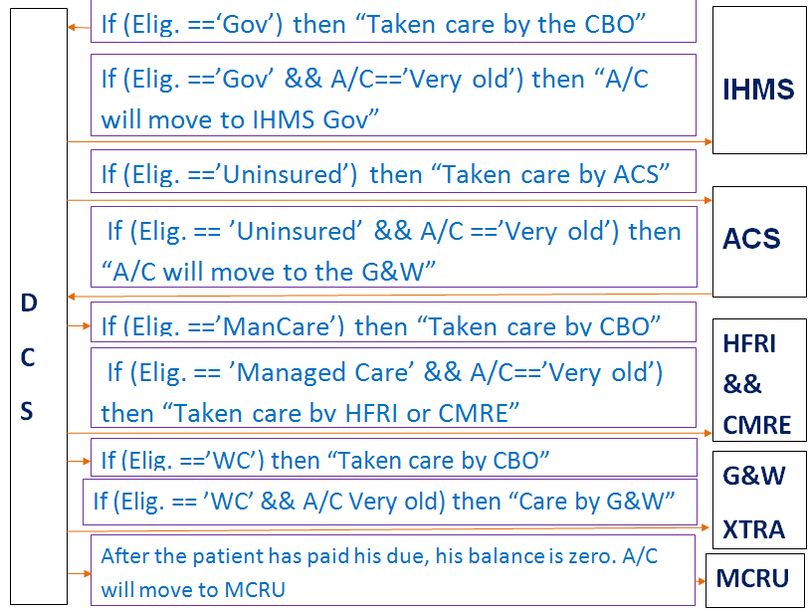

Slide 13
Payment to CHW CBO
    “In current scenario IHMS and ACS do not
    receive payments. They do collection efforts on
    behalf of CHW, but patients are directed to send
    payments to CHW CBO”

Slide 14
Why Access?
Based off the user’s job (s), the user will have the routines they need to perform their job duties.
Central Coast:
At CC External user have only view access
Different vendors have different access
View the insurance or review on the behalf of patient
View Demographic screen
View Payment or validate payment information

Slide 15
Cont…
San Joaquin Sierra:
At SJS External user have edit access in few facility
Financial counseling purpose
Different vendors have different access
View the insurance or sometime needs to check registration information
View Demographic screen or View Payment or validate payment information

Slide 16
How to provide Meditech Access?
Fill out Vendor Maintenance and Service Account Request Form or bulk request form.
Sign NUP document, if user doesn’t have LANID
A gatekeeper request needs to be raised (Mellonie, Yolanda).
Signed scanned copies (VM and NUP) needs to be submitted to the “Security team”.
Security provisioning team will provide Meditech icons and will have Meditech team to provide role base accesses on Meditech screen.

Slide 17
Meditech has three primary Access levels
UNIVERSE LEVEL
MIS LEVEL
Application
Access

Slide 18

UNIVERSE LEVEL
  The UNV database User dictionary stores the basic information on a user such
User ID,
Name
Grant PIN
Reset PIN
Provides link to Single sign on (Network Username)

Slide 19




MIS LEVEL
Menus/Jobs
Access Groups
FOCUS
Profile
NPR Applications

Slide 20
MIS LEVEL
Person Dictionary
Used to create Users and Providers
Menu Procedure Access Dictionary
Used to design menu/procedure access sets.

Slide 21
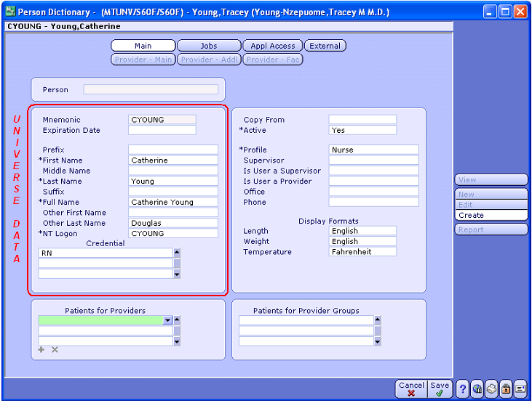
PERSON DICTIONARY

Slide 22
Application Level
Access Dictionary.
  Group of users that has been authorized (in an Access dictionary) to use a specific set of functions or routines.
  Access groups allow you to assign a degree of access to a group of users who perform similar tasks.
  You can also define certain default settings for those users.

Slide 23
IHMS Agency Code
    IMEAR2 is used when no insurance found and
    IHMS no longer wants to review the account then
    this Account will move to ACSAR.
    IMEAR6 is used if there is an incorrect transfer of an
    account to IHMS where we transfer an account with
    an insurance balance shouldn't happen

Slide 24
ACS Agency Code
ACSAR (Account has been assigned for ACS for follow-up.)
ACSAR5 (ACS letting CHW Business Office know that the account did not load into ACS due to error)
ACSAR12 (Return for Credit Balance)

Slide 25
IHMS Files
Outbound Files:
Daily (Both Eligibility and Gov.)
Reconciliation and Bad Debt (Both Eligibility and Gov.)
Inbound Files:
The return files for IHMS only contain return code to indicate that the agency follow-up is completed or wrong Account etc.

Slide 26
ACS Files
Outbound Files:
Daily, Recon and ReconBD
Inbound Files:
Return AR (ACS return AR contains the reason for error, why these accounts not able to load at ACS)
ACS Notes (file contains the following information e.g
- Missing Relative Name
- Missing Employer Name
- Missing Demographic information etc.

Slide 27
Grant & Weber Files
Outbound Files:
Daily and ReconBD
Inbound Files:
Daily inbound
Remittance and Reports
“G&W collects on behalf of G&W, payments are sent
To GW. GW then sends the CHW CBO a monthly
file to post payments into Meditech”

Slide 28
Reading References
acs-inc.com
grantweber.com
ihmsllc.com
xtradepartment.com
http://hfri.net/
cmrefsi.com

Slide 29
Thank You

